Slide 1
Picture Lock
By Navjot Singh

Slide 2
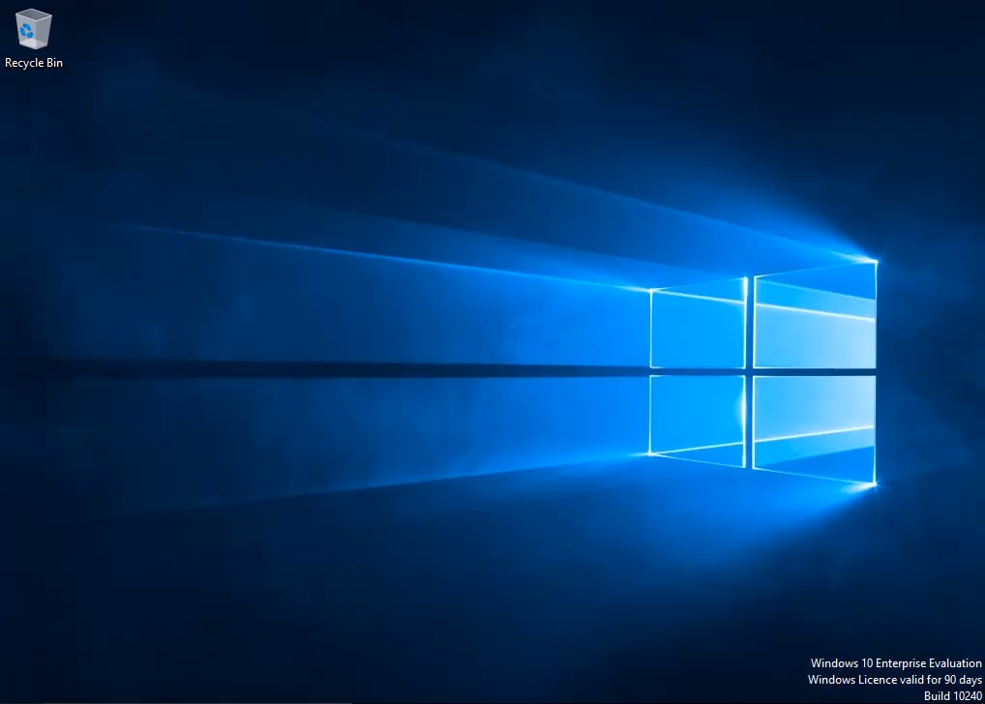
Setting Up
Click the windows icon on the bottom left corner
Click on settings
Go to accounts → Sign In Options
Scroll down to Picture password
Enter your password
Locate the picture → Click use this picture
Now you will perform the gestures which include: click, swipe and circle.

Slide 3
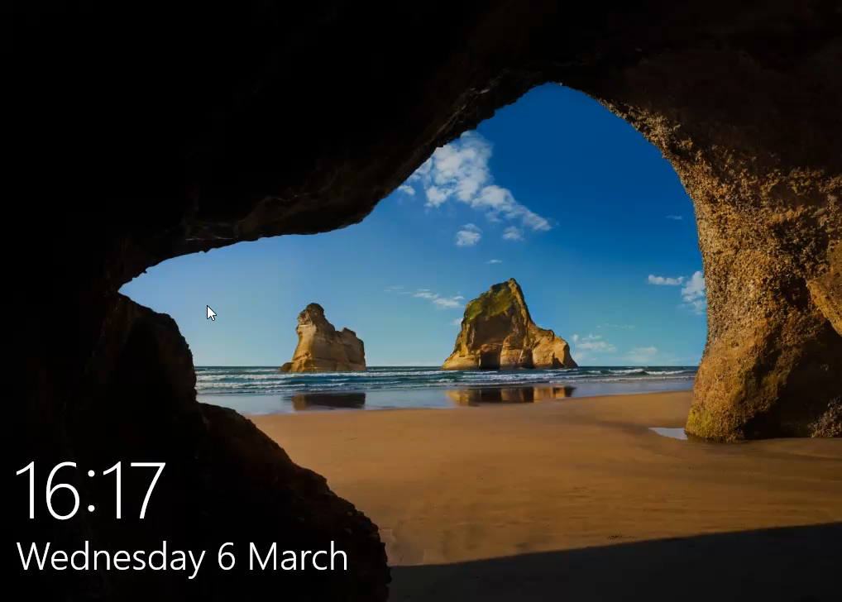
Test

Slide 4
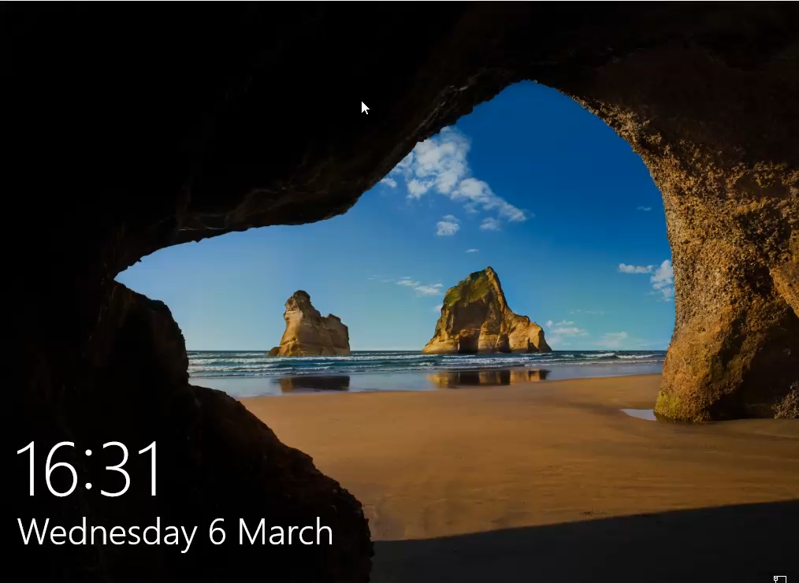
Test 2
Here in this test I purposefully enter the password incorrectly. I also enter the password but I click a few inches away from the pre-set gestures and it still unlocks.

Slide 5
Justify
Picture password is useful because it does not require the user to type in complex characters to remember, just the gestures.
It is easy for any user, because you simply click on the image and perform gestures.
If you struggle with patterns then you may struggle with this feature
After various test I have seen that this feature isn’t necessarily secure. Because it is easy to guess what gestures users have used. Also, it is not as accurate because you could click a few inches away from where you originally set the gesture and it will still process and unlock.
On touch screen devices you could see the smudges on the screen which will give away the gestures the user has inputted.
Needs a pin setup for backup

